Slide 1
Modeling Discard in Stock Synthesis

Slide 2
Retention and discard mortality
Retention is a logistic function of size with parameter for asymptotic retention rate
Offset from inflection parameter for males
Discard mortality also logistic with asymptote and male offset
dead fish = sel∙(ret + (1-ret)*disc)

Slide 3
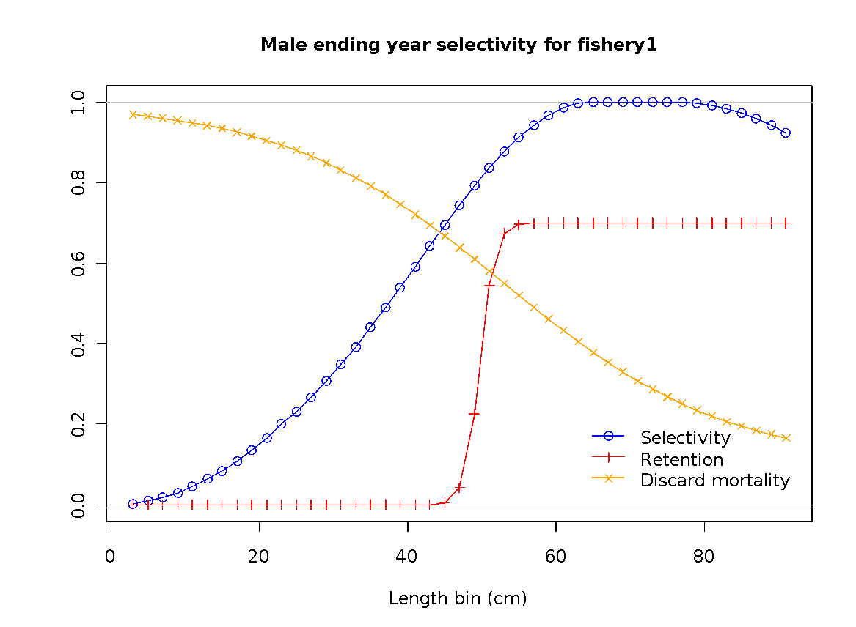
Retention and discard mortality

Slide 4
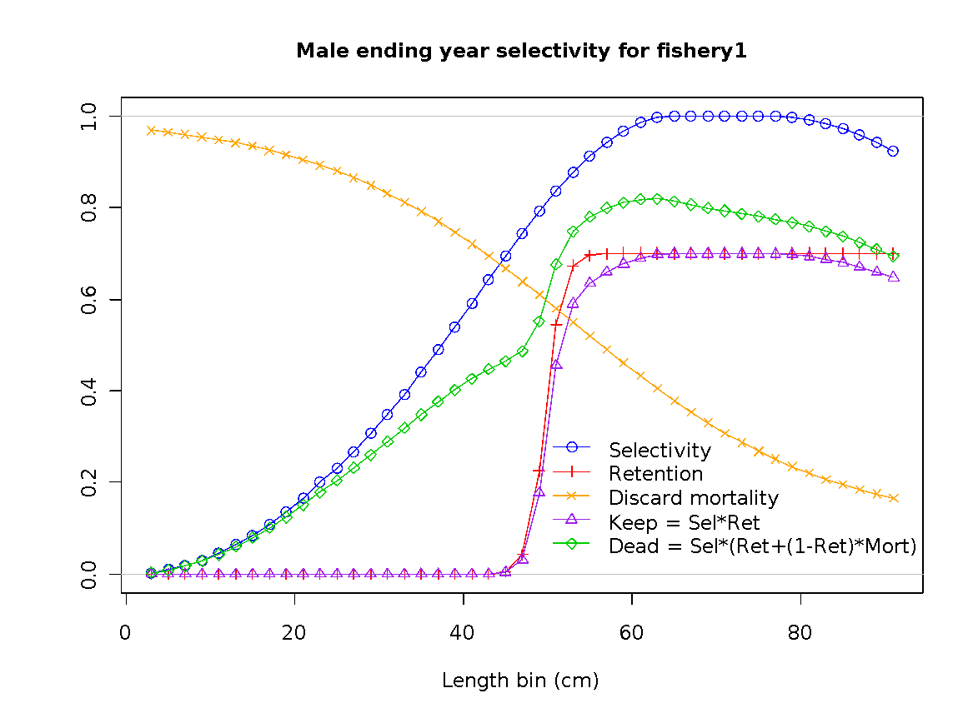
Retention and discard mortality

Slide 5
Bycatch Fleet
6/21/2012 3.24d
set catch_se=-1 to ignore catch logL for this fleet;
still need a catch value(ignored) for each year to trigger estimation of F;
also need a time series of discard and/or effort from which the F will be estimated.

Slide 6
Bycatch Fleet – all discard
7/12/2012 3.24e
Setting the discard option in the size-selectivity section to a value of 3 will cause retention to be set to 0.0 for all sizes and discard mortality to be set to 1.0 for all sizes.
No parameters are read.
0 = all retained, no discard, no parameters read
1 =read 4 retention parameters, all discarded fish are dead
2=read 4 retention and 4 discard mortality parameters
3=none retained, all discard dead, no parameters are read

Slide 7
Getting F for Bycatch Fleet
Do F as parameters and use informative prior
Enter time series of discard amount
Do as super-year if annual fluctuations are just noise
Get annual changes in F by entering a survey as type=2, which is an index proportional to F (so q=1/q)

Slide 8
Bycatch fleet - issue
A bycatch fleet is still a fleet, so when searching for Fmsy & Fspr, its F level is scaled up and down with all the other fleets as if it is a controllable target fleet
SS3.30 will provide a wider range of options for managing bycatch fleets

Slide 9
Fleet Specifications in 3.30
#_fleet_type: 1=catch fleet; 2=bycatch only fleet; 3=survey; 4=ignore
#_survey_timing: -1=for use of catch-at-age to override the month value associated with a datum
#_fleet_area: area the fleet/survey operates in
#_units of catch: 1=bio; 2=num (ignored for surveys; their units read later)
#_equ_catch_se: standard error of log(initial equilibrium catch)
#_catch_se: standard error of log(catch); can be overridden in control file with detailed F input
#_rows are fleets
fleet_type | timing | area | units | equ_catch_se | catch_se | need_catch_mult | fleetname
1 | -1 | 1 | 1 | .05 | .05 | 1 | HL_E
2 | -1 | 1 | 1 | .05 | .05 | 1 | Shrimp_E
#Bycatch_fleet_input_goes_next
#a: 1=use retention curve like other fleets; 2=all discarded
#b: 1=deadfish in MSY, ABC and other benchmark and forecast output; 2=omit from MSY and ABC (but still include the mortality)
#c: 1=Fmult scales with other fleets; 2=bycatch F constant at input value; 3=bycatch F form range of years
#d: F or first year of range
#e: last year of range
# a b c d e

Slide 10
Discard Time Series - Issue
If discard is mostly small/young fish
And retention curve is constant over time
Then fluctuations in observed discard will appear to be a recruitment signal to SS
Consider time-varying selectivity &/or retention as alternative explanation for the discard fluctuations

